Slide 1



GEG MIS PORTAL
User Guide
SEPTEMBER, 2024

Slide 2
GEG MIS EXPANSION
DEMO

Slide 3
Home Page – Login as Program Officer

Slide 4
At a Glance – Navigate to Pre-Registration

Slide 5
Pre-Registration

Slide 6
Pre-Registration – View Pre-Registered List

Slide 7
Pre-Registration – Add

Slide 8
Pre-Registration – Add

Slide 9
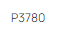
Pre-Registration – Enable/Disable, Edit and Delete

Slide 10
Registration Program Officer

Slide 11
Registration – View Pending Participant List

Slide 12
Registration – Add Participant – Search

Slide 13
Registration – Add Participant – Fill Details

Slide 14
Registration – Add Participant – Fill Details

Slide 15
Registration – Add Participant – Fill Details

Slide 16
Registration – Participant Registration pending for Approval

Slide 17
Registration Approval Program Manager

Slide 18
Registration – Approve

Slide 19
Approve POP-UP – Yes

Slide 20
View Notifications – Registration – Approved

Slide 21
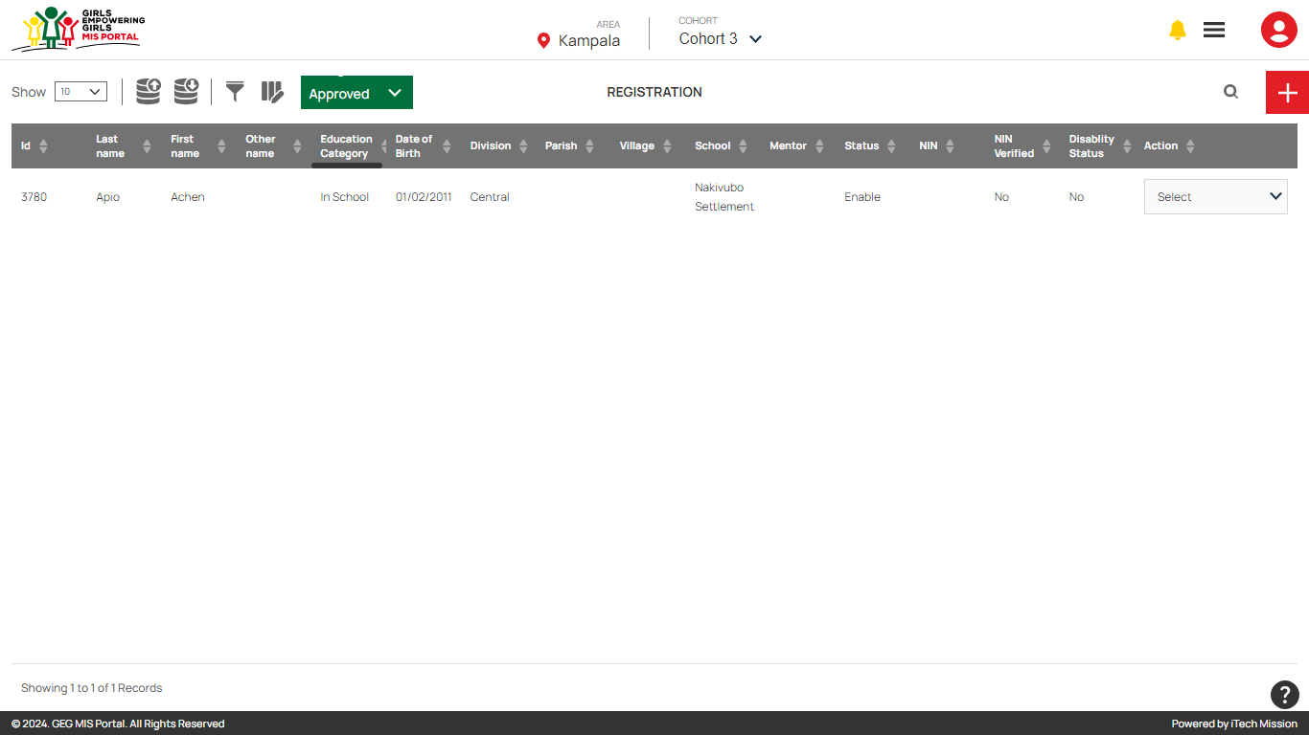
Participant Registration – View Approved Registration List

Slide 22
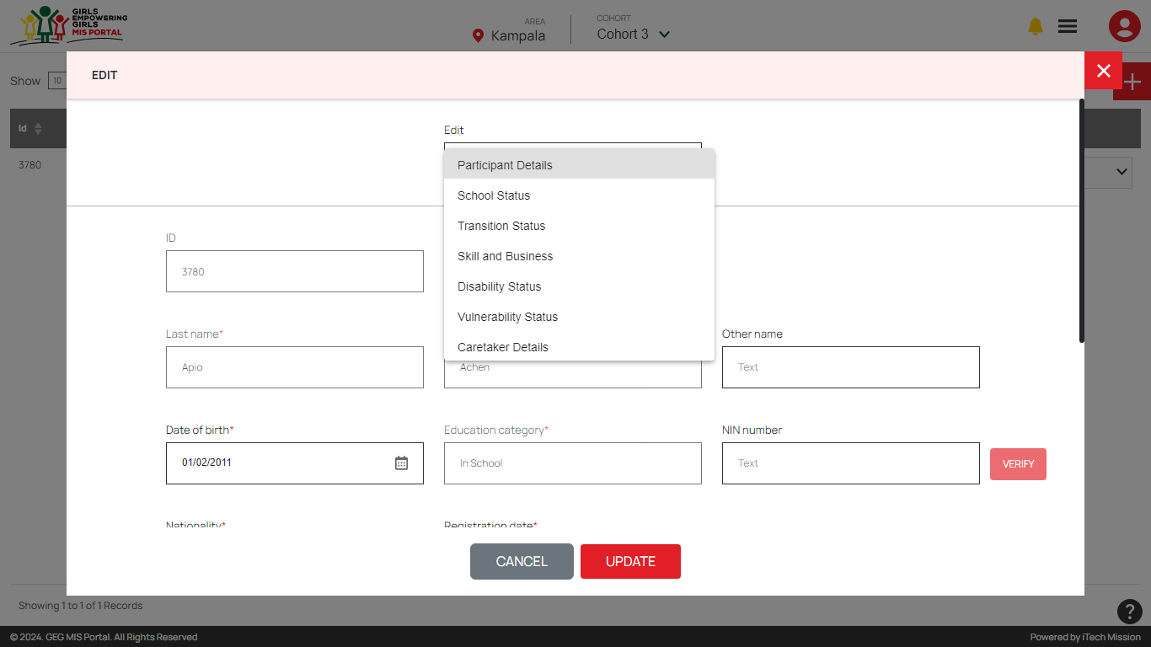
Participant Registration – Edit Approved Registration

Slide 23
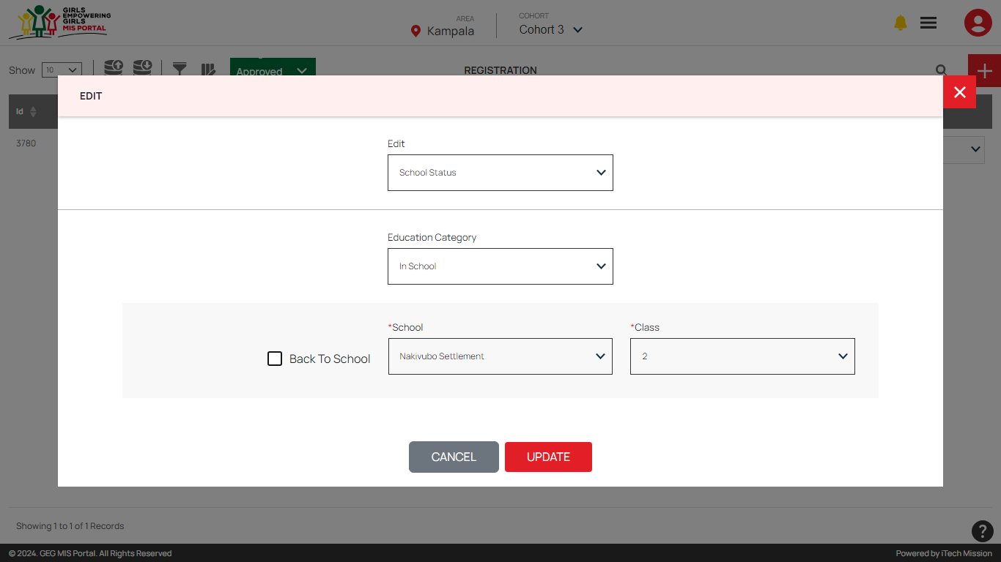
Approved Participant Registration – Edit – School Status

Slide 24
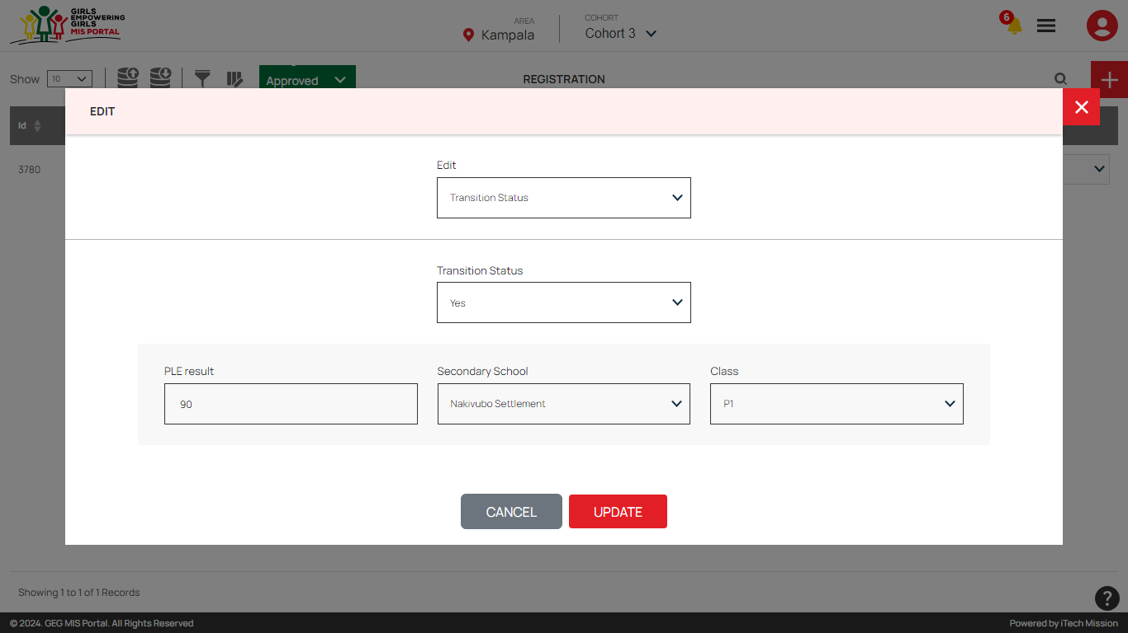
Approved Participant Registration – Edit – Transition Status

Slide 25
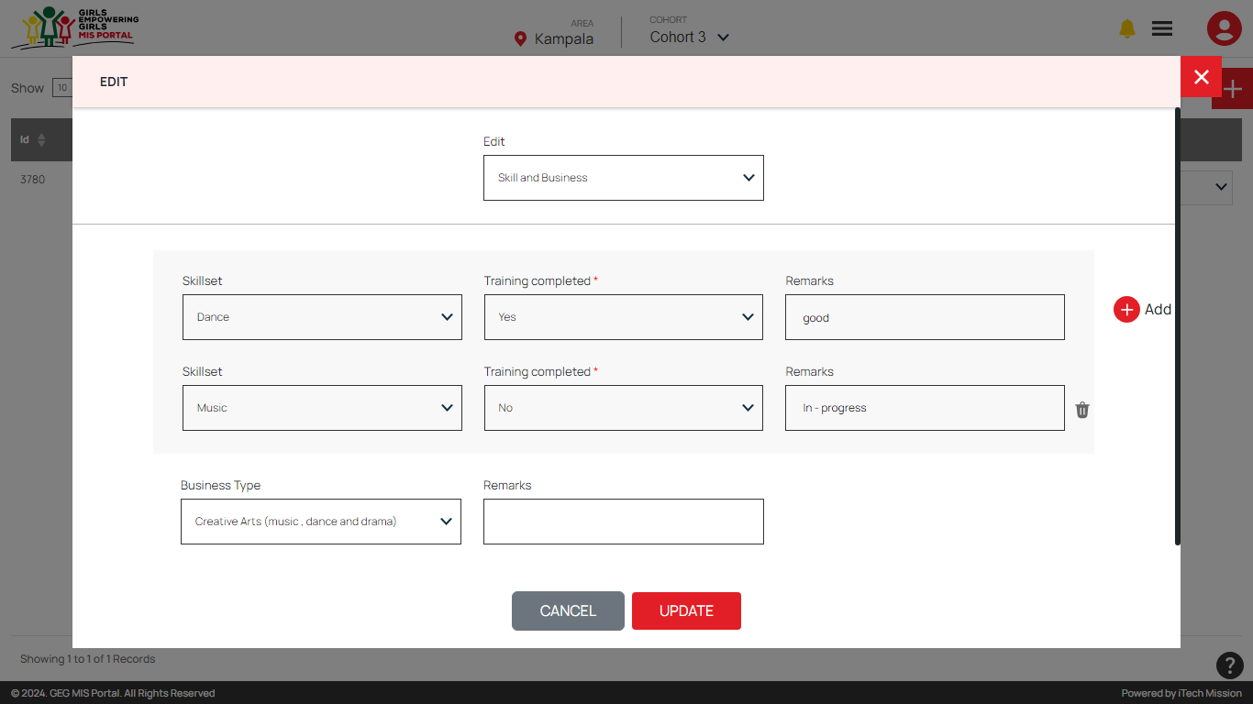
Approved Participant Registration – Edit – Skill and Business Status

Slide 26
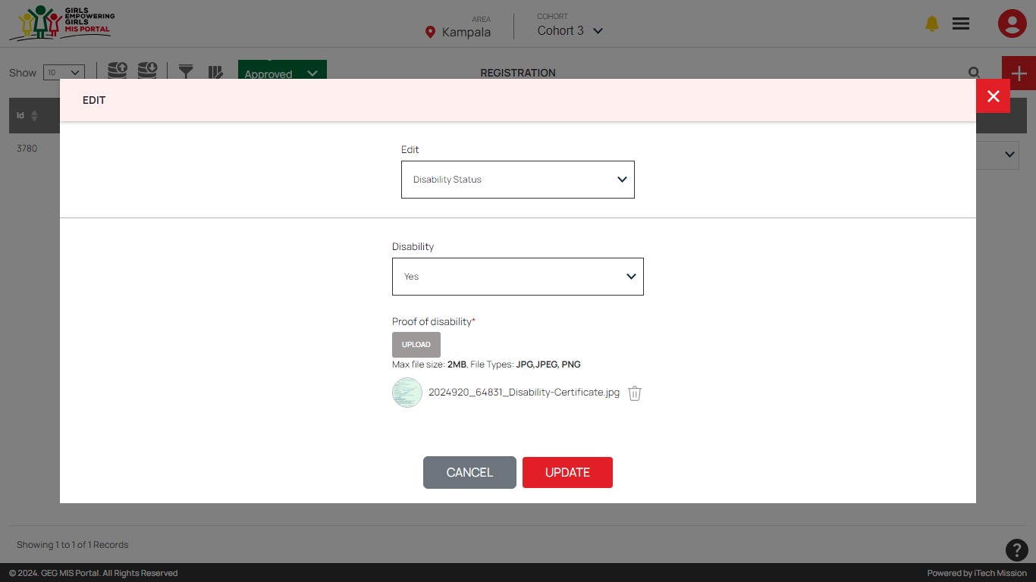
Approved Participant Registration – Edit – Disability Status

Slide 27
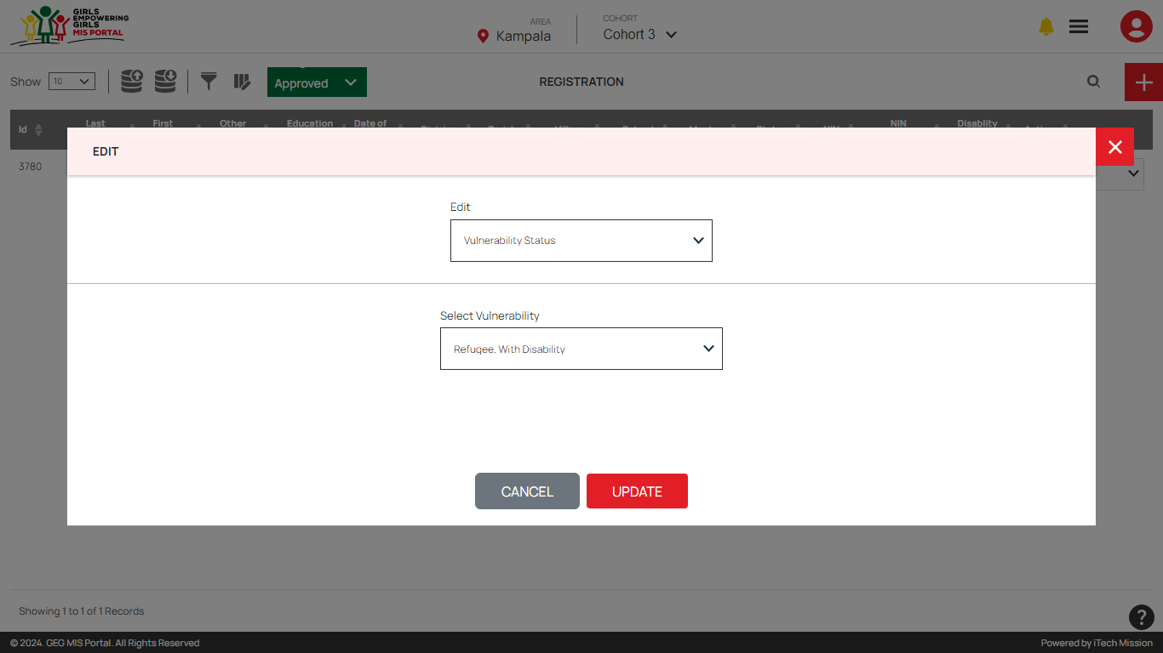
Approved Participant Registration – Edit – Vulnerability Status

Slide 28
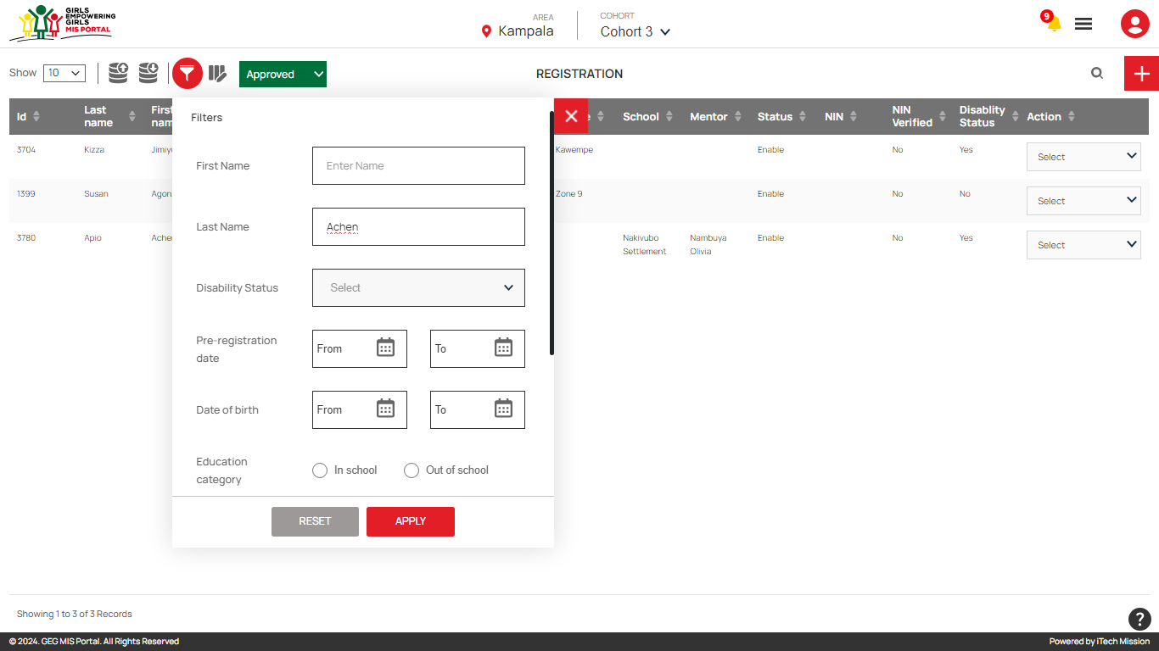
Approved Participant Registration – Add Filter

Slide 29
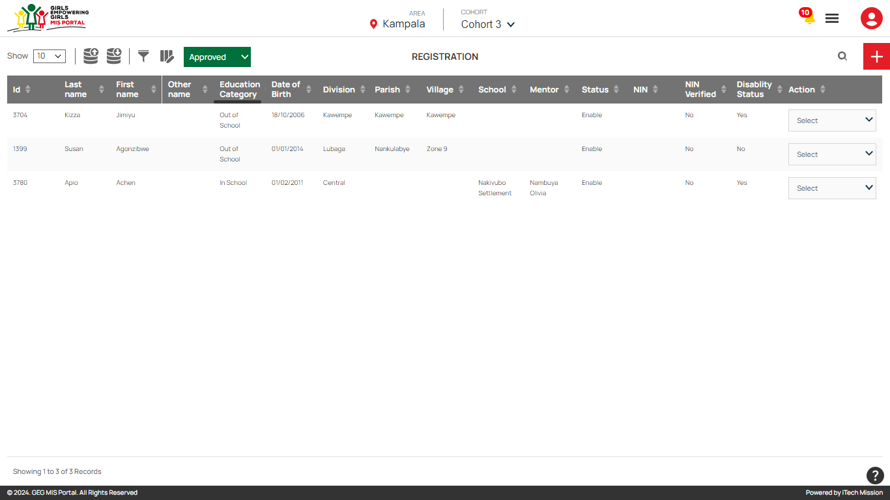
Approved Participant Registration – Add Filter – Export Filtered Data

Slide 30
Assign Mentor Program Officer

Slide 31
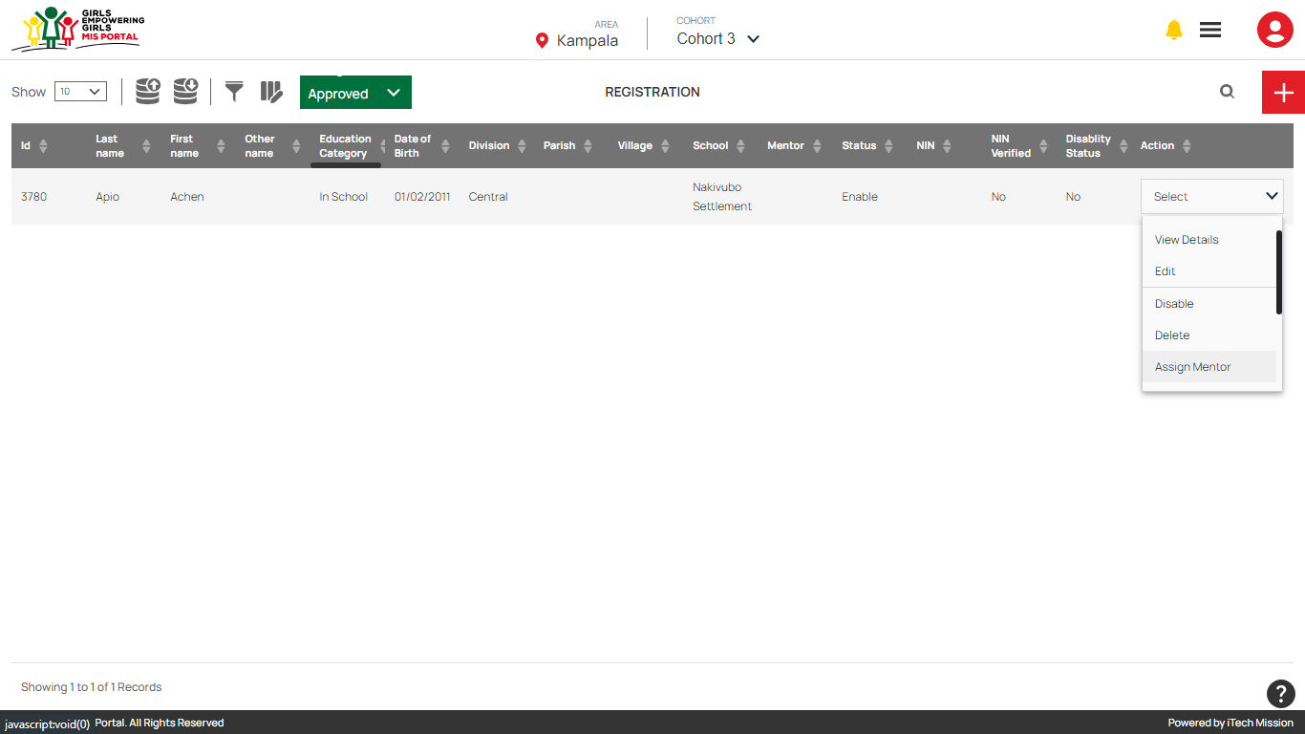
Registration – Approved – Assign Mentor

Slide 32
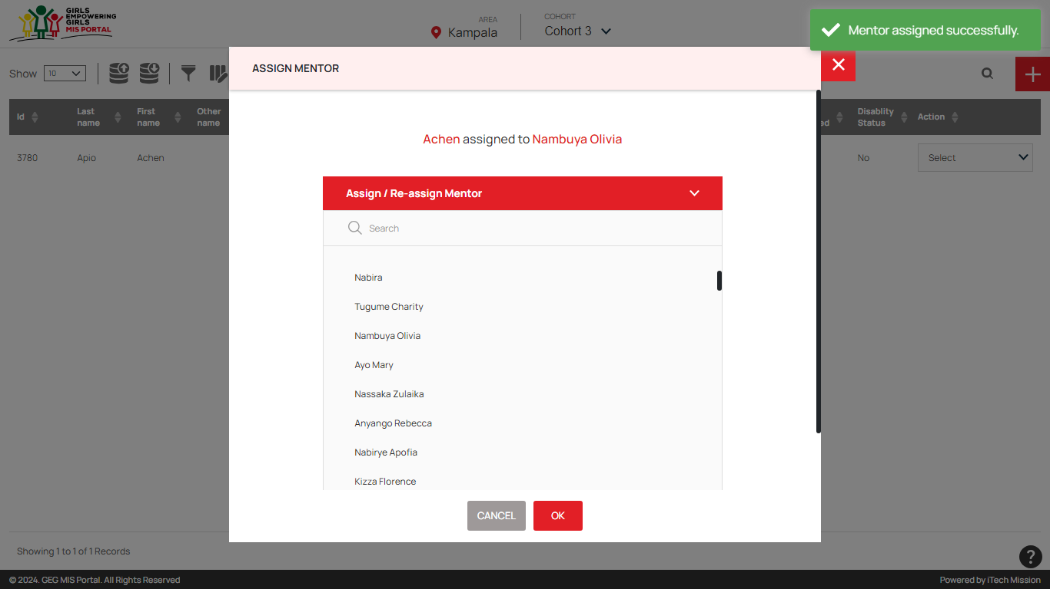
Registration – Assign Mentor

Slide 33
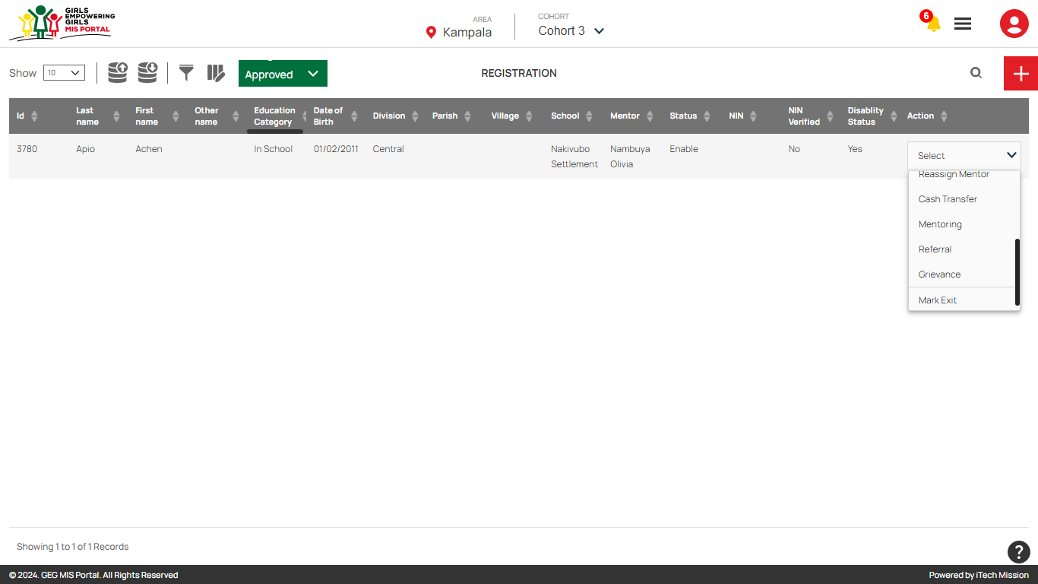
Registration – Reassign Mentor, Cash Transfer, Mentoring, Referral, Grievance, Mark Exit

Slide 34
Cash Transfer Program Officer

Slide 35
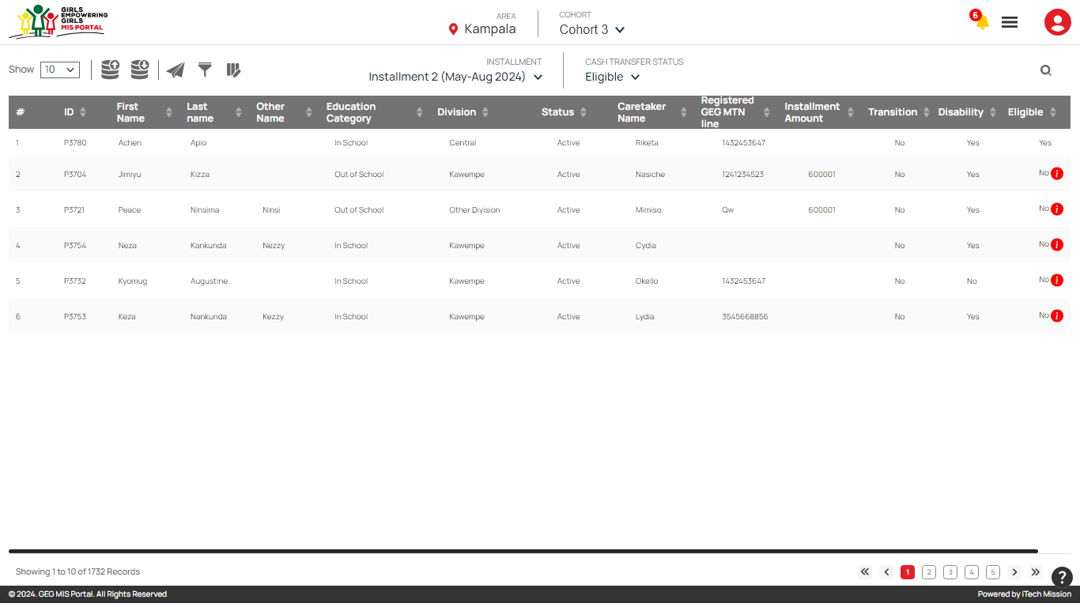
Cash Transfer – Select Cohort, Installment and Cash Transfer Status

Slide 36
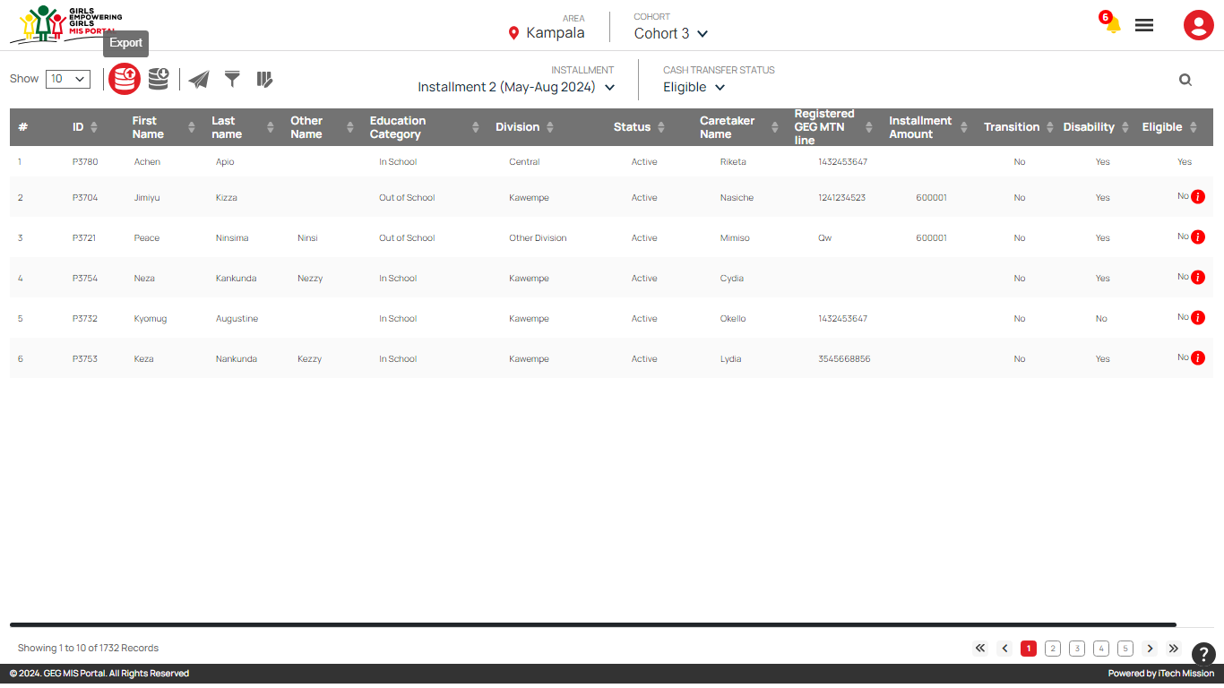
Cash Transfer – Export Eligibility List

Slide 37
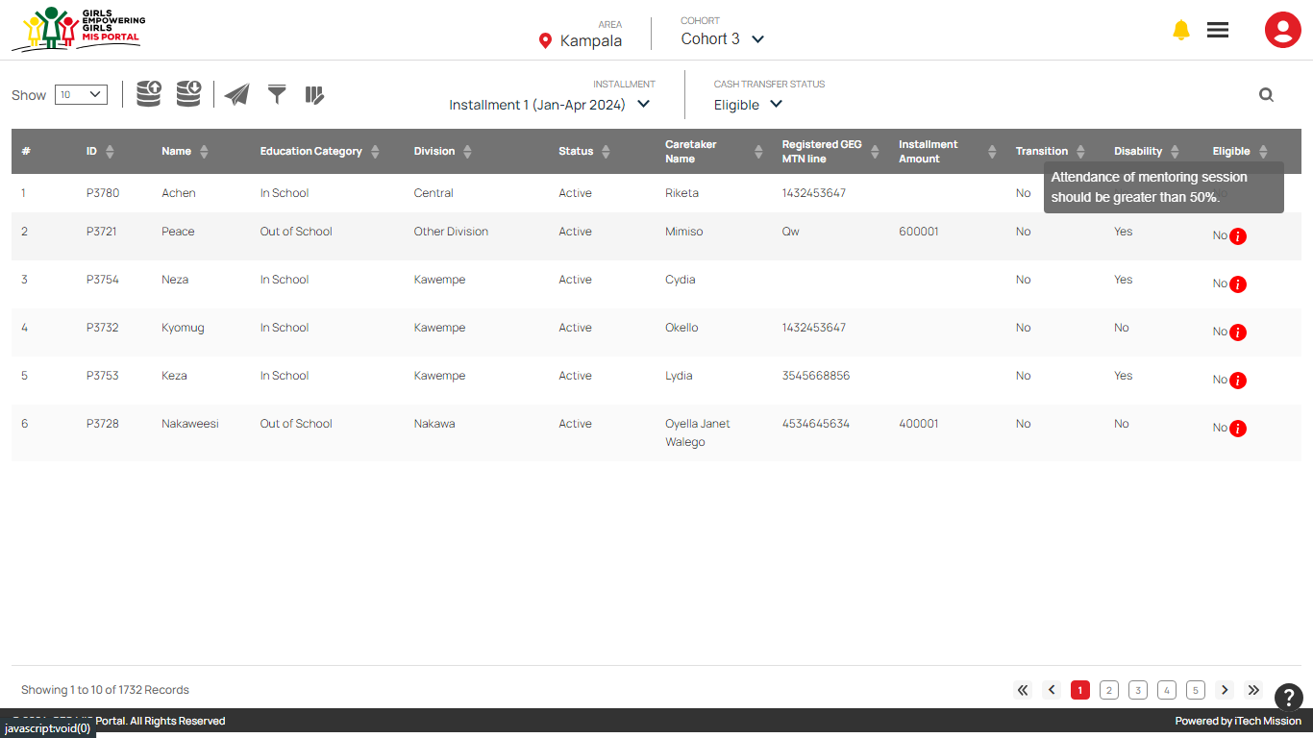
Cash Transfer – View Not Eligible Reason

Slide 38
Mentoring Peer Mentor

Slide 39
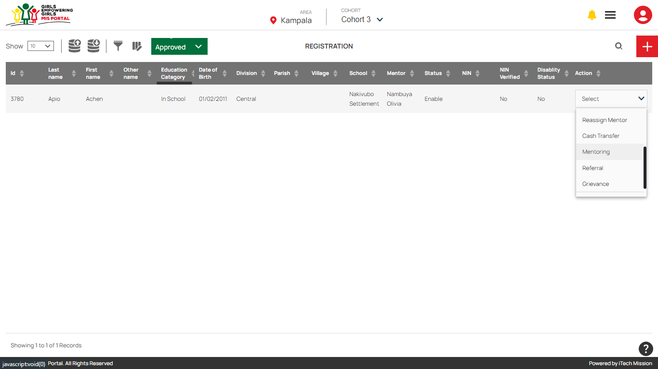
Registration – Mentoring

Slide 40
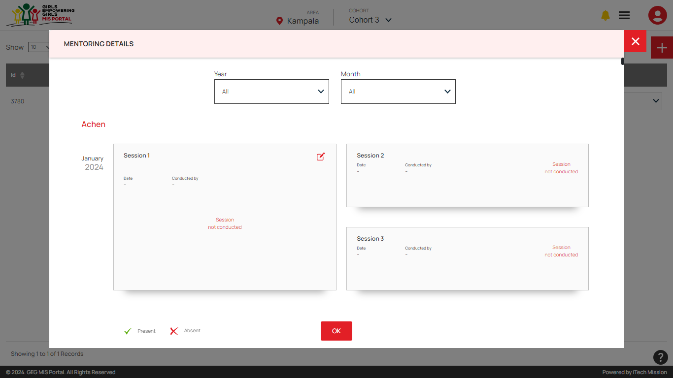
Registration – Mentoring – Edit

Slide 41
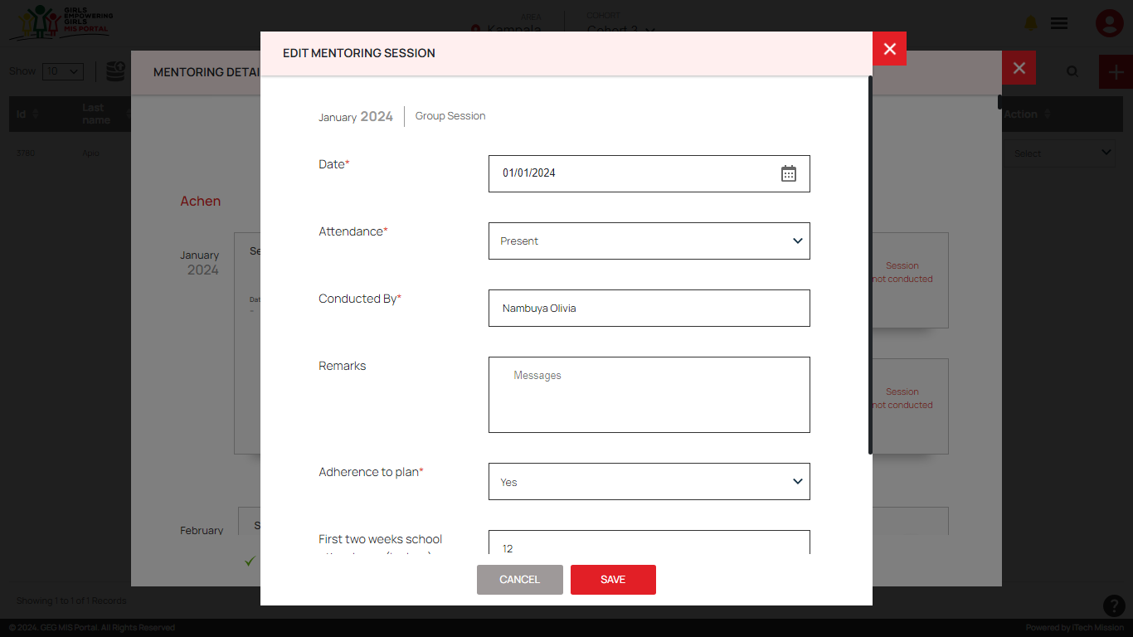
Registration – Mentoring – Edit Group Session

Slide 42
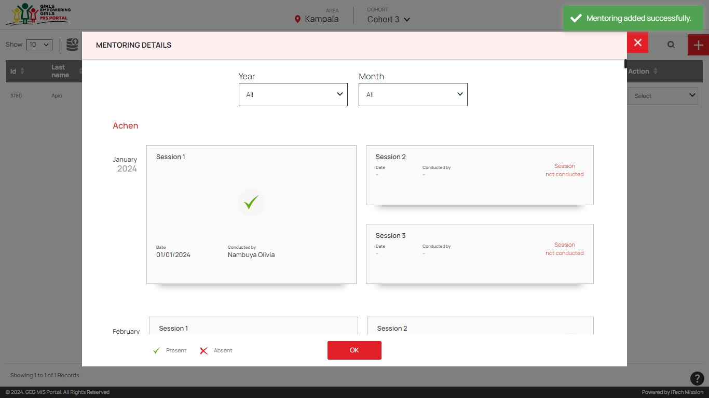
Registration – Mentoring – Group Session Added

Slide 43
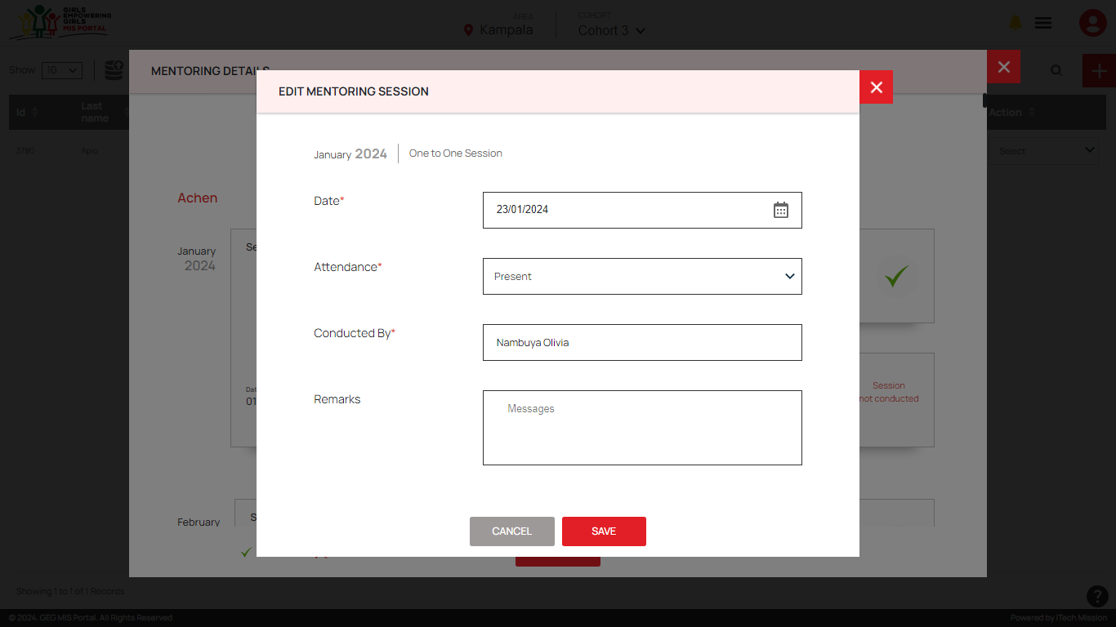
Registration – Mentoring – Edit One to One Session

Slide 44
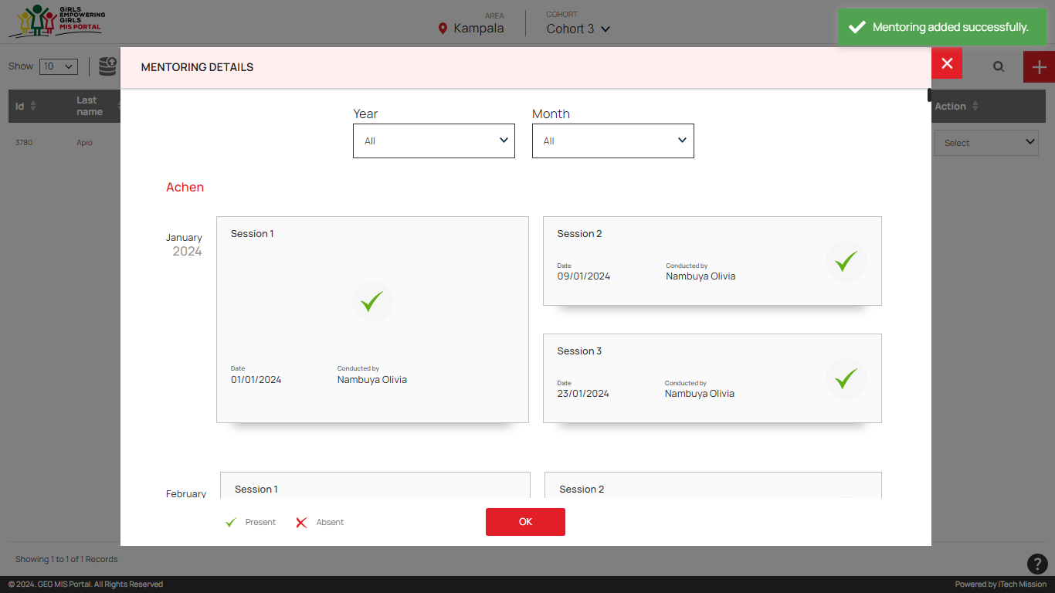
Registration – Mentoring – One to One Session Added

Slide 45
Cash Transfer – First Verification Program Coordinator

Slide 46
Cash Transfer – First Verification

Slide 47
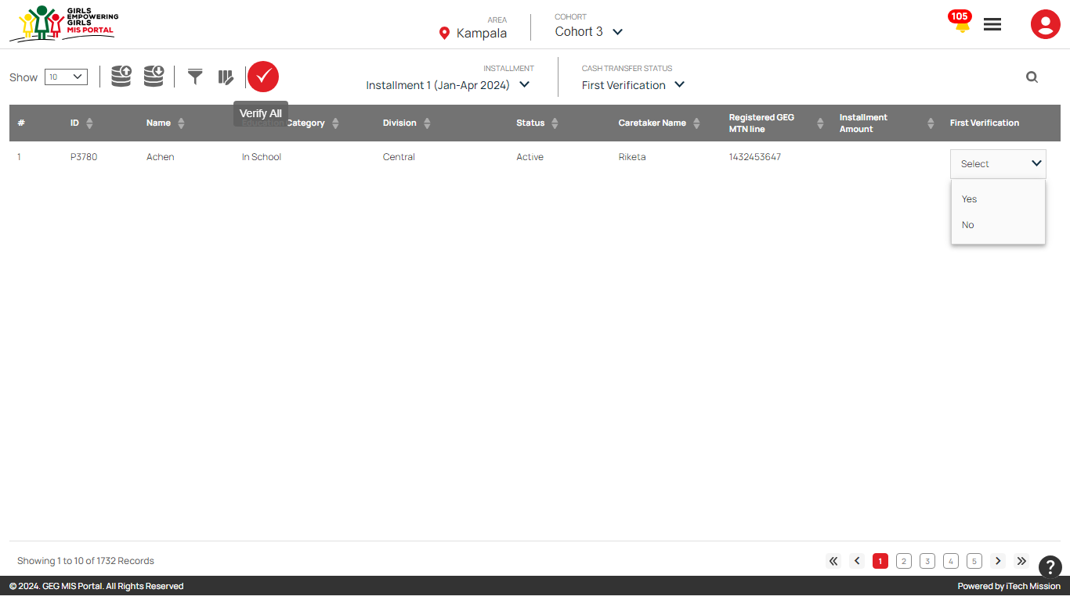
Cash Transfer – First Verification – Yes/No

Slide 48
Cash Transfer – First Verification – Verification Completed

Slide 49
Cash Transfer – First Verification – Export and Import

Slide 50
Cash Transfer – Second Verification Lead Partner

Slide 51
Cash Transfer – Second Verification

Slide 52
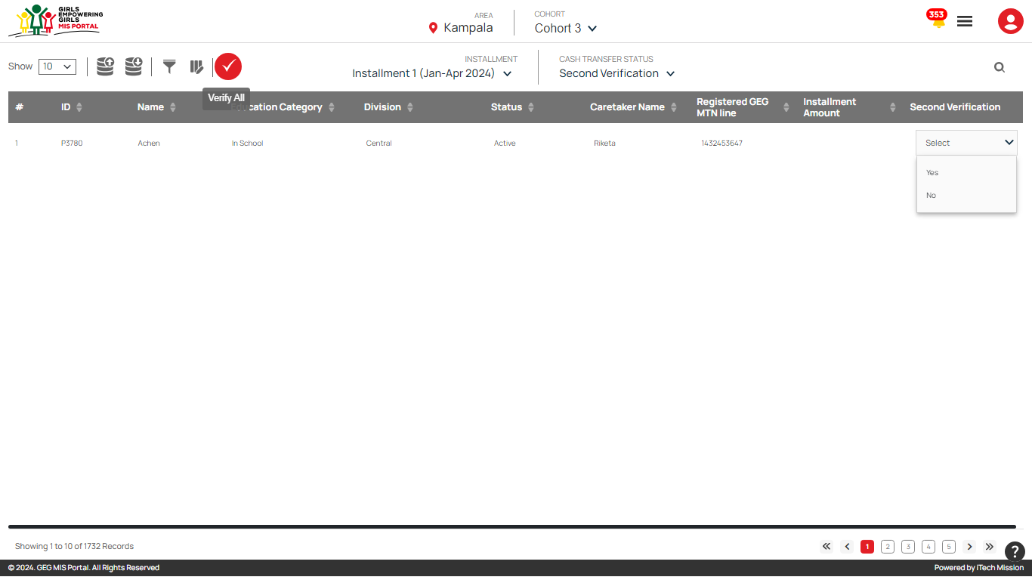
Cash Transfer – Second Verification – Yes/No

Slide 53
Cash Transfer – Second Verification – Verification Completed

Slide 54
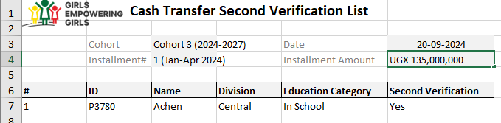
Cash Transfer – Second Verification – Export and Import

Slide 55
Cash Transfer – Approval Program Manager

Slide 56
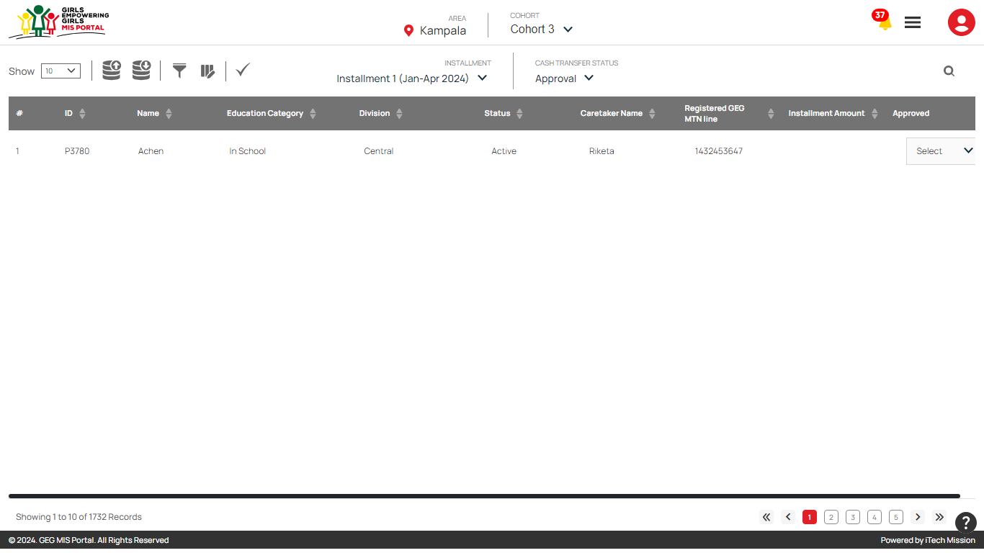
Cash Transfer – Approval

Slide 57
Cash Transfer – Approval – Yes/No

Slide 58
Cash Transfer – Approval – Approved

Slide 59
Cash Transfer – Approval – Export and Import

Slide 60
Cash Transfer – Payment Program Officer

Slide 61
Cash Transfer – Payment

Slide 62
Cash Transfer – Payment – Pay

Slide 63
Cash Transfer – Payment – Payment Status and Date

Slide 64
Cash Transfer – Payment – Pay Notification

Slide 65
Mark Exit – Program Officer

Slide 66
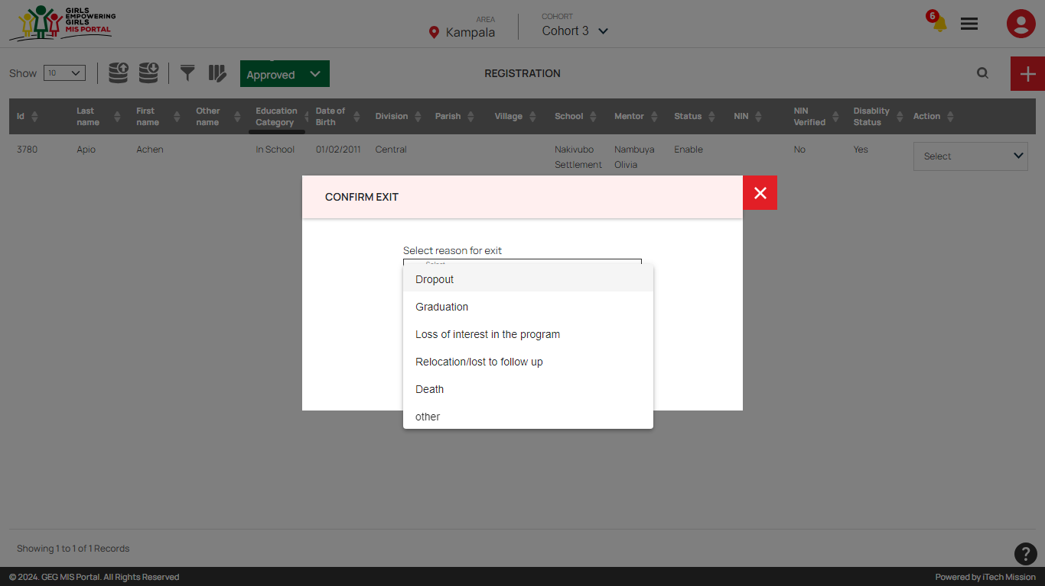
Registration – Mark Exit – Reason

Slide 67
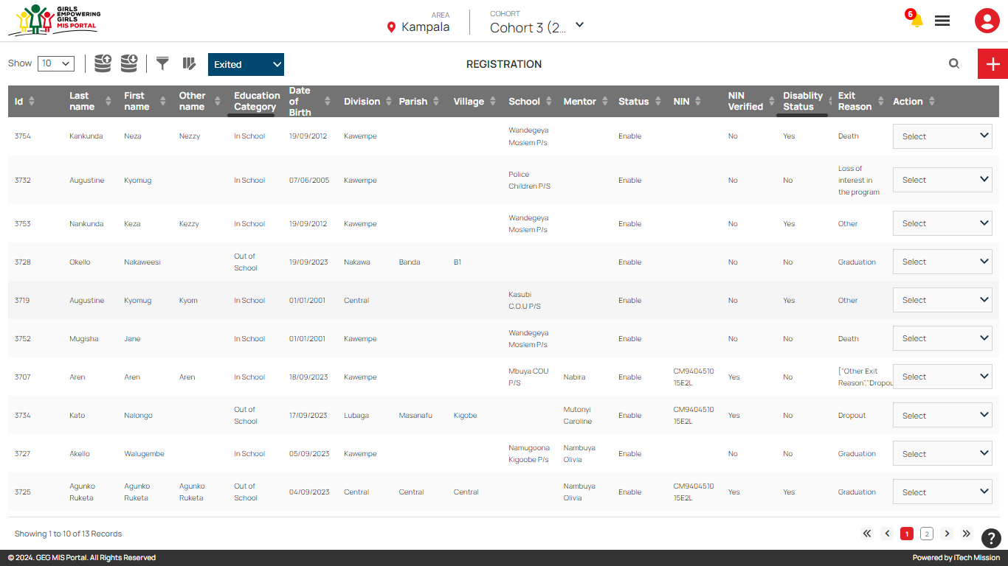
Registration – View Exited Participant List

Slide 68




